Slide 1
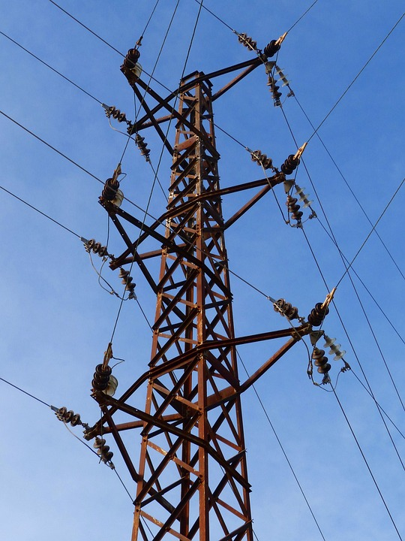
US ELECTRIC GRID OUTAGES
JAN 2002-JULY 2023

Slide 2
Project Overview
The dataset includes electric outage incidents in the U.S. power grid from January 2002 to July 2023, collected via Form DOE-417, with details on event times, locations, demand loss, and affected populations.
The objective is to clean the data and create a Power BI dashboard that visualizes trends and key insights over 21 years of outage data, including summaries of events and impacts

Slide 3



Project Objective
The goal of this project is to analyze event-level power outage data from 2002 to 2023 and provide insights to the U.S. Department of Energy (DOE).
By consolidating, cleaning, and visualizing the data using Power BI, the project aims to uncover patterns and trends in electricity outages, quantify their impacts on affected communities, identify potential weak points in the U.S. power grid, and also propose recommended solutions to help them in making data driven decisions.
Based on insights, actionable recommendations will be made to enhance grid performance, reduce outage durations, and improve communication strategies with affected customers during outages.

Slide 4
Problem Analysis
Extreme Weather Events
Climate change intensifies hurricanes, wildfires, and ice storms.
Aging Infrastructure
Components over 50 years old, prone to failure, and costly to repair.
Poor Maintenance and Investment
Budget constraints lead to reactive maintenance and delayed upgrades.

Slide 5
Implications
Regulatory Pressure
Government and energy regulators face scrutiny for inadequate grid preparedness and management.
Operational Impacts
Disruptions to households and critical sectors (manufacturing, transport, healthcare).Increased complexity in restoring power after widespread disruptions.
System Overload
High demand during heat waves or cold snaps overwhelms the grid.

Slide 6
STAKEHOLDERS
Utility Companies
Commercial Industrial Consumers
Residential Consumers
Regulatory Agencies (e.g., FERC, NERC)
Investors and shareholders

Slide 7
KPI
01
Total Number of outages
Total Demand Loss
Total Number of Customers Affected
Total Duration Days
Overall Analysis
02
Total Events by Season
Seasonal Event type analysis
Impact of event types on customers
Demand Loss by event type
Average Duration by Event type
Event Types
03
Total Customer affected in NERC Region
Total Demand loss in NERC Region
Events and Maximum days in NERC Region
NERC Region Analysis
04
Customers affected by year
Total Demand loss by year
Average of Duration by year
Events and number of NERC region by Month and Quarter
Trend Analysis

Slide 8

Data Cleaning
Rows Cleanup
Remove empty rows.
Remove unnecessary rows (e.g., "null" values).
Promote proper rows to headers.
Replace values with standardized terms.
Post-Appending Cleaning Steps
Update data types for columns such as Date and Time (Event Began, Restoration).
Use conditional "IF else" logic for cleaning key columns (e.g., Date, Time, Customers Affected and Demand Loss).
Categorize event types.
Extract text before delimiter in Demand Loss.
Ensure correct data types for all fields. • Categorize alert criteria.
Calculate duration column in days.
Filter out invalid or negative values in event duration columns (12 Events). Replace invalid data in all columns. Remove duplicate rows or values
Add custom columns for calculating durations in hours.
Trim and clean NERC Region based on the latest standards.
Remove unused or obsolete columns (e.g., old NERC Region, Event Type, Alert Criteria).
Columns Cleanup
Filter Columns & Replace Values
Exclude blank values in key columns (e.g., NERC Region, Date, Time Event Began).
Extract month and year from the date columns.
Rename columns for clarity and consistency.
Remove unnecessary columns.
Handling errors with "null" in relevant columns.
Apply unique transformations for each year (2002-2023).
Split datetime columns by delimiters to date and time columns.

Slide 9
Exploratory Data Analysis
Total events: 3949 The total number of events that occurred in the power grid from 2002 to 2023.
Total demand loss: 1,186K The total amount of demand that was lost due to events.
Total people affected: 361M The total number of people who were affected by events.
The WECC region had the most events, with 1.11K events occurring between 2002 and 2023. This represents 40.3% of all events.
Severe weather is the leading impact on customers, accounting for 61.27% of all customers affected. This includes events such as hurricanes, tornadoes, floods, and wildfires. These events can cause widespread damage to infrastructure, leading to outages.
Severe weather also causes the most demand loss, accounting for 0.29M of all demand loss. This is because severe weather can cause outages at large generating facilities, leading to a loss of supply.

Slide 10
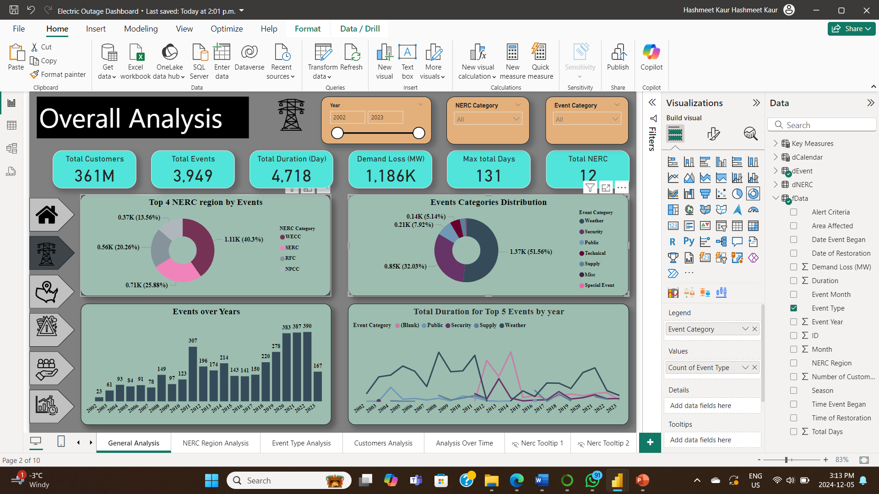
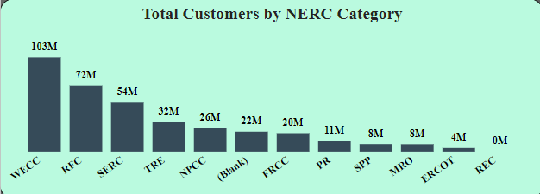
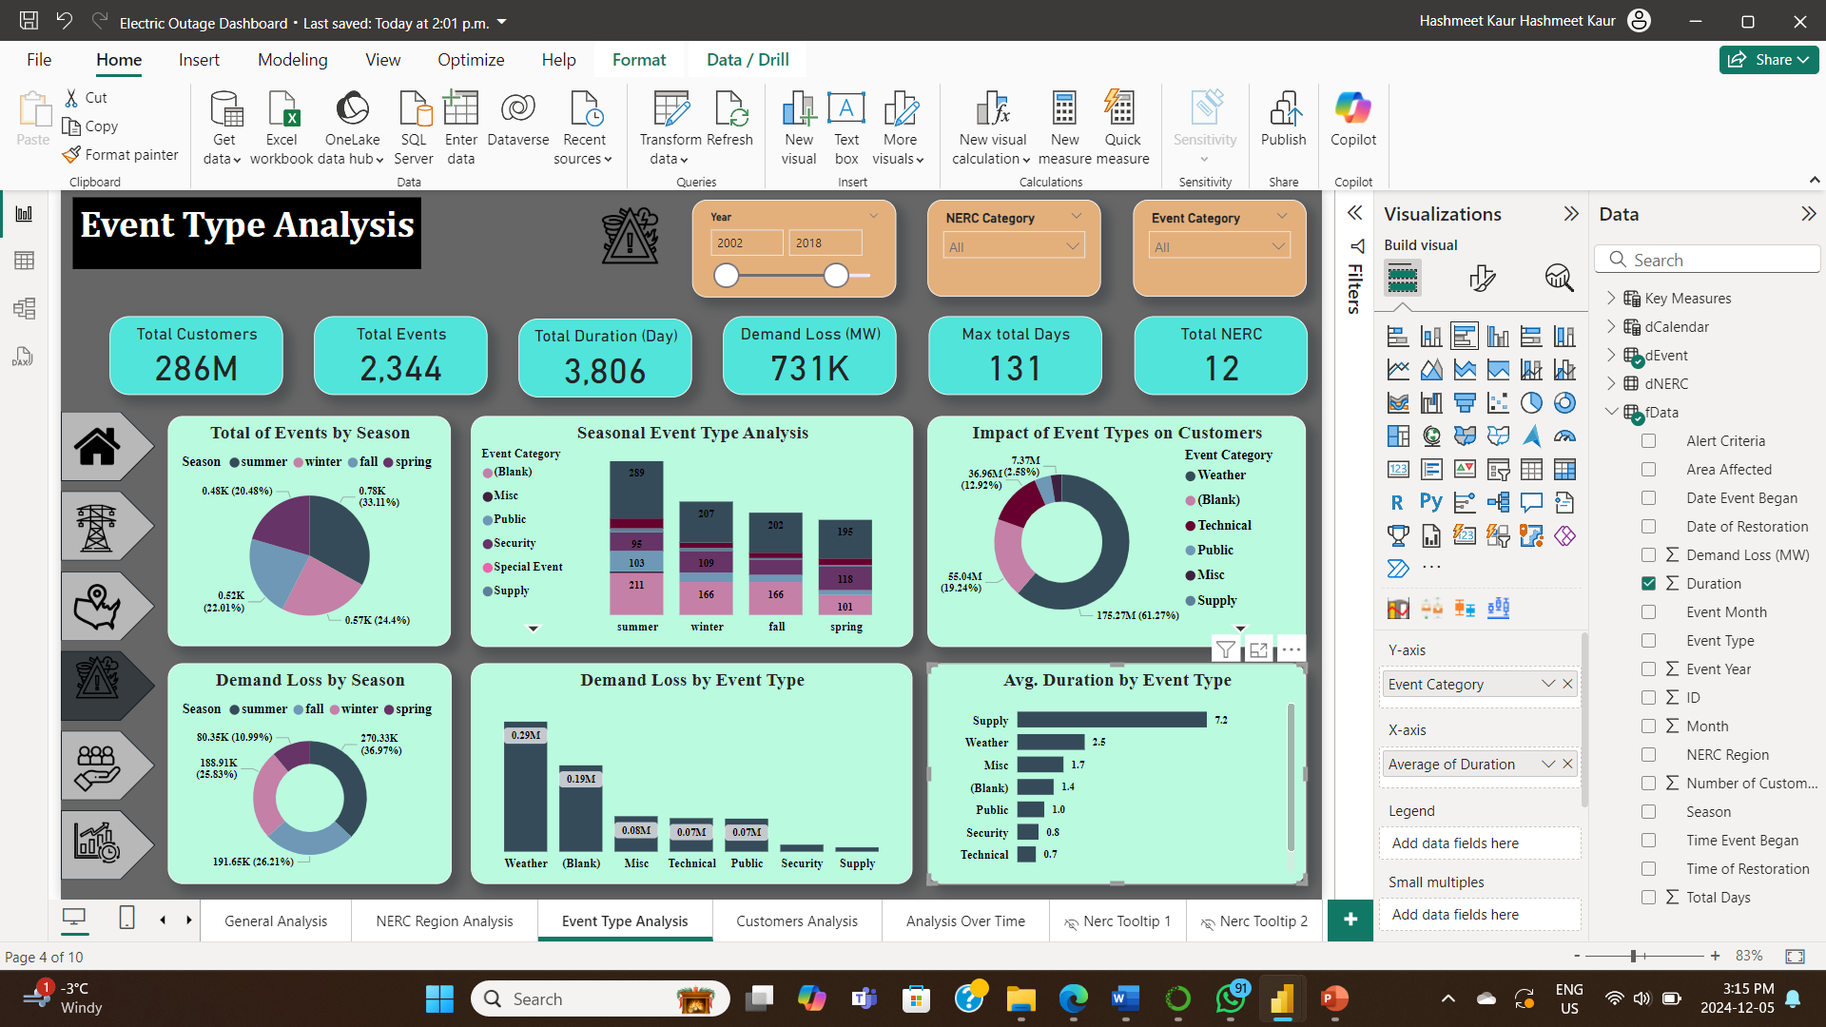
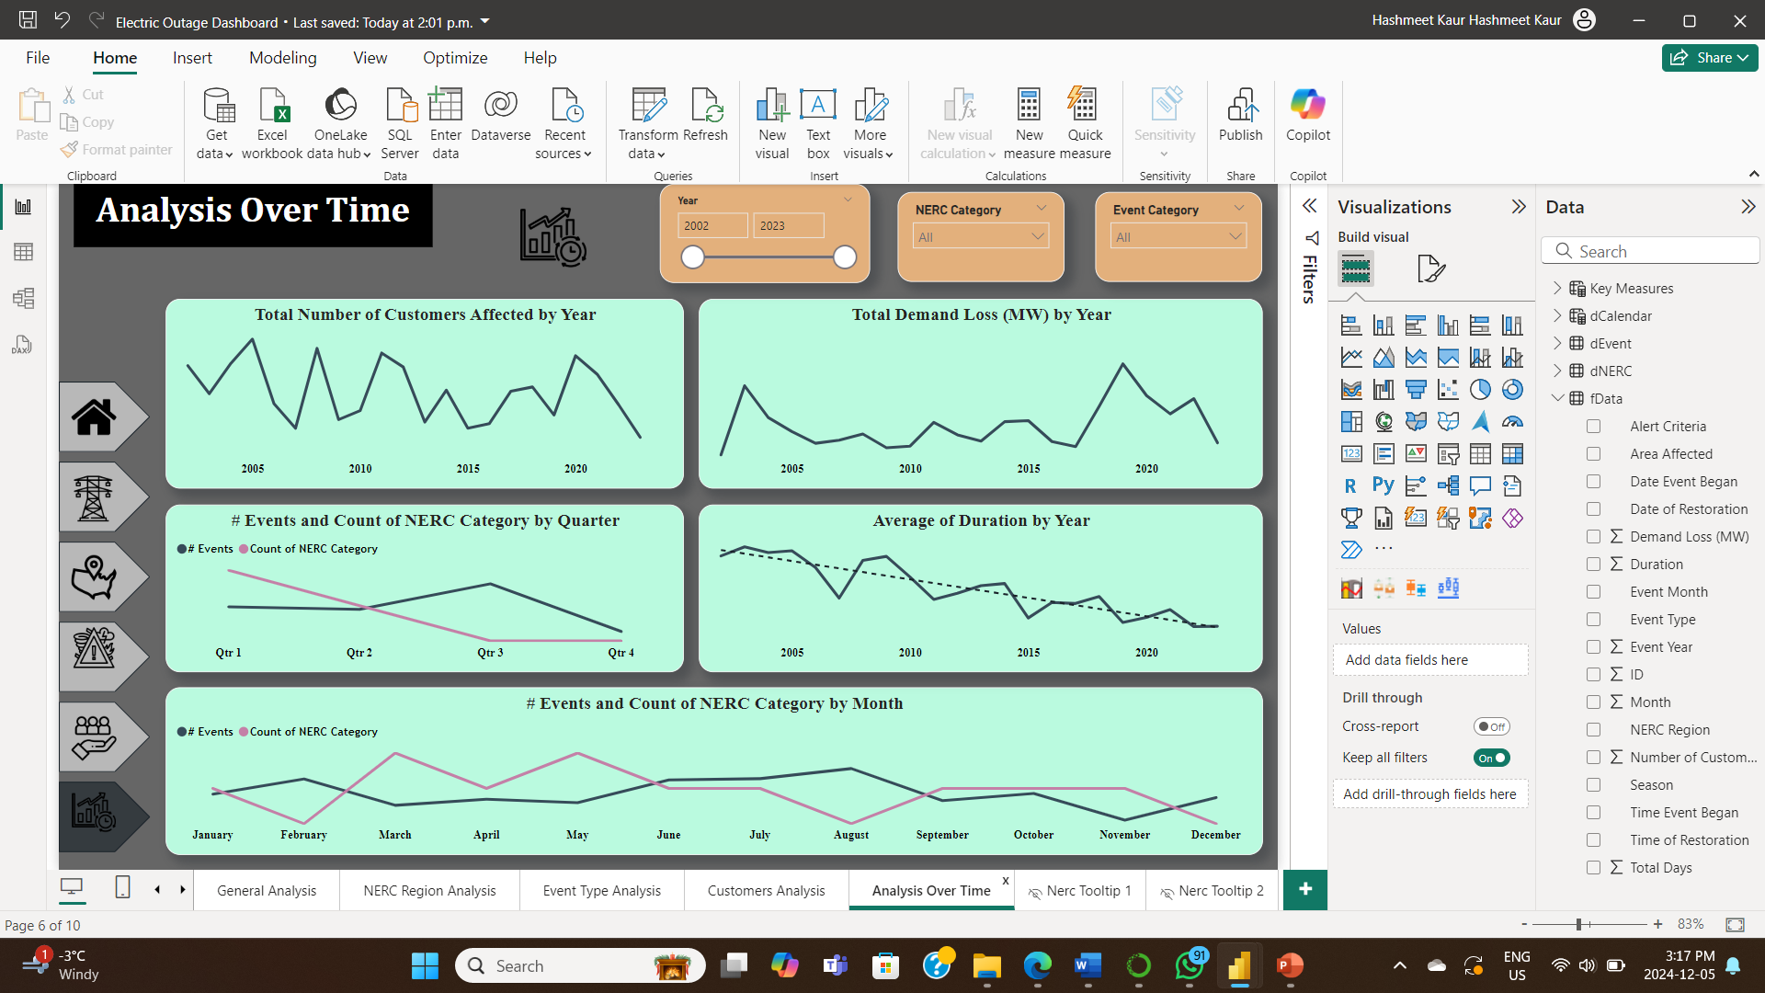

Slide 11
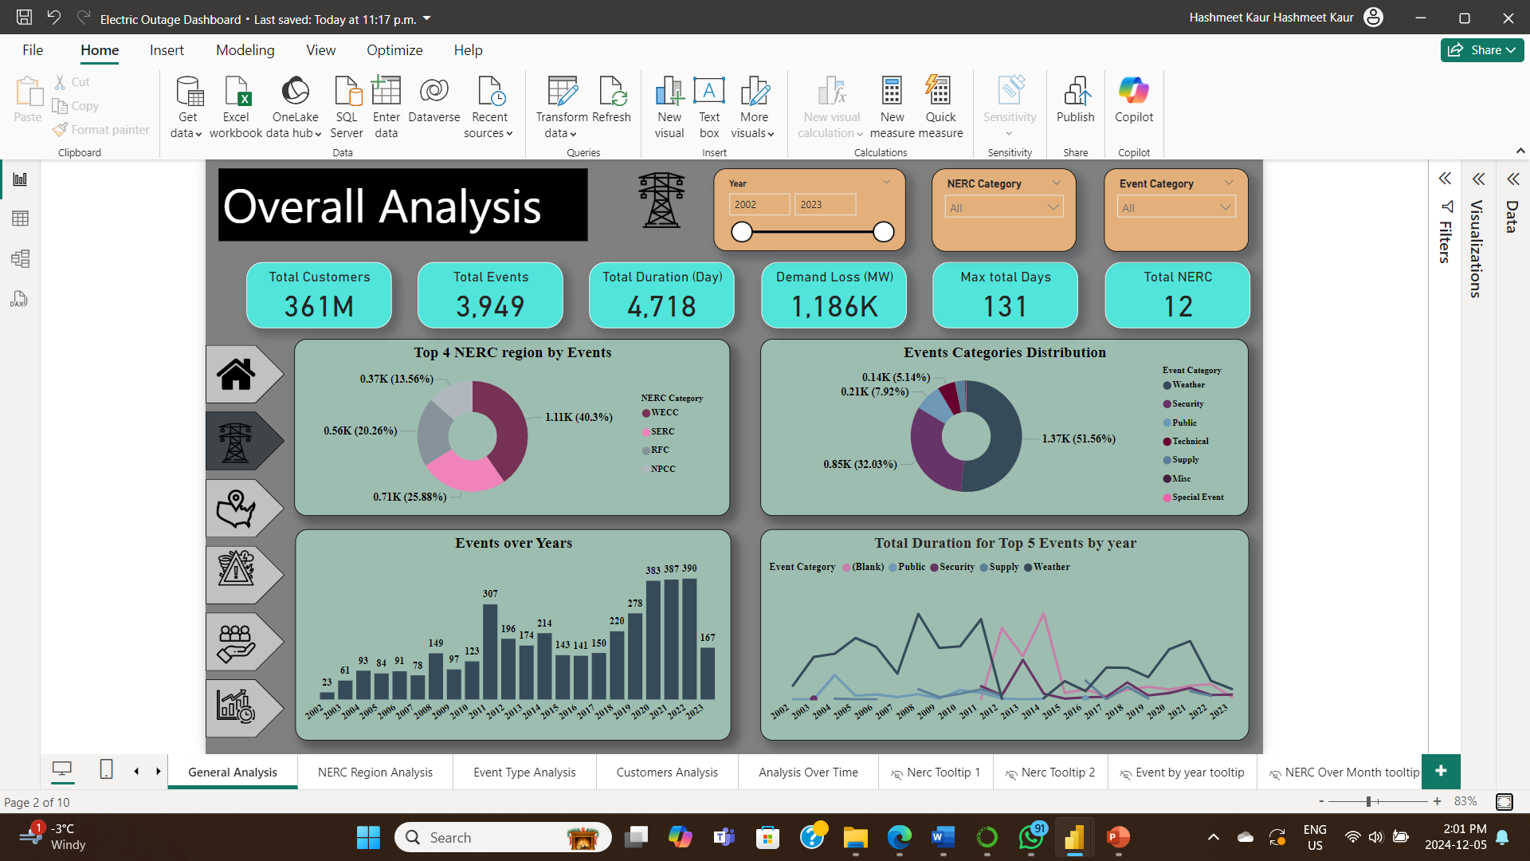
Dashboard

Slide 12




Recommendations
Improve Customer Communication
Implement proactive, real-time outage notifications.
Provide transparent outage information via online platforms.
Offer safeguard warnings for high- risk weather events.
Optimize Capacity Planning
Analyze demand fluctuations for better load management.
Upgrade aging infrastructure in high-outage areas.
Enhanced Grid Stability
Invest in weather-resistant infrastructure.
Implement predictive maintenance for equipment.
Diversify power sources with renewable energy
Reduce Outage Durations
Use real-time monitoring and advanced sensors.
Strengthen and equip quick response teams.
Automate restoration processes with self-healing grids

